Slide 1
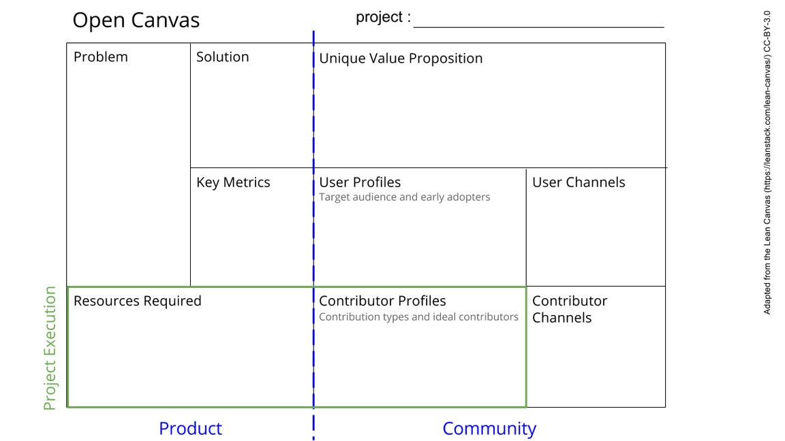
Help Me Invest!
Lack of understanding about investment options and how they work.
No consolidated, crowd-sourced, privacy first, easy to use one-stop-shop for individuals looking to get into investments and financial planning.
Web app that allows users to enter their financial details anonymously and get suggestions on the best investment options.
- Crowd-sourced open data on financial investment options.
- Privacy-first approach to handling user data.
- Open Source web application
- Consolidated, Simple and Easy interface.
- Prototypes.
- Number of contributors.
- Number of users.
- GitHub
- Social Media
- Blogs
- Word of mouth
Everyday folks around the world, who face challenges in deriving the most value out of their hard-earned money, due to lack of understanding of various financial options.
- Design & Prototypes [Adobe XD]
- Development [Vue js based client app & Node js backend]
- Deployment [DigitalOcean Droplet]
- Contributors / Community [GitHub]
- Designers [To help simplify the UI and improve UX]
- Developers [Preferably proficient with Vue js and Node js]
- Community members [Add, update and maintain financial options data]
- GitHub
- Social Media
- Blogs
- Word of mouth
Notes:
Go to File > Make a Copy… to make your own canvas
See next slide for instructions

